Slide 1

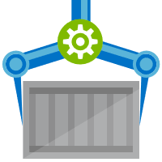
ACR Task
A feature of Azure Container Registry
aka.ms/acr/tasks

Slide 2

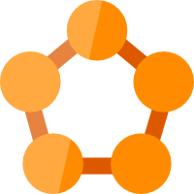
















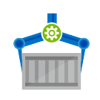
Azure Container Registry
App Service
Service Fabric
Kubernetes Service
Container Instance
Batch
Webhooks
Event Grid
Scanned, Secure & Signed
Azure Container Registry
Azure Security Center
Signed w/Content Trust
Build & Patch with ACR Tasks

Slide 3
Container Security
Encrypted At Rest
RBAC Authenticated
Quarantined – providing secure by default registries
Scanned by leading industry partners
Image Signing w/Content Trust

Slide 4
Registry Storage
Encrypted At Rest
Geo-redundant storage for all tiers – ^{Azure Storage GRS}
Docker & OCI Image Formats
Helm Charts – first public cloud to support Helm Chart Repos
Providing multi-container, parameterized definitions

Slide 5


Release Management
Resource Pool
Orchestration
HOST-A
Deploy:
web:1 x3
quotes:1 x3
important:1 x4
Image Cache
3
web:1
digest: 91e
web:1
digest: 91e
Foo:
web:1 x3
quotes:1 x3
important:1 x4
web:1
digest: 91e
quotes:1
digest: u82
Container Builder
important:1
digest: 2re
important:1
digest: 2re
Container Registry
HOST-B
Image Cache
quotes:1
digest: u82
quotes:1
digest: u82
7
6
quotes:1
digest: u82
5
web:1
digest: 91e
important:1
digest: 2re
important:1
digest: 2re
important:1
digest: 2re
quotes:1
digest: u82
1
quotes:1
digest: u82
docker build –t web:1
docker build –t quotes:1
docker build –t important:1
docker push web:1
docker push quotes:1
docker push important:1
important:1
digest: 2re
important:1
digest: 2re
Image
web:1
quotes:1
important:1
2
Digests
91e
u82
2re
web:1
digest: 91e
HOST-C
quotes:1
digest: u82
4
important:1
digest: 2re
8
Image Cache
quotes:1
digest: u82
quotes:1
digest: u82
important:1
digest: 2re
important:1
digest: 2re
Notes:
Orchestrator icon from: http://cdn.marketplaceimages.windowsphone.com/v8/images/f58edb21-b20c-4315-b837-6cee21n442cd?imageType=ws_icon_large
https://git-scm.com/book/en/v2/Git-Branching-Basic-Branching-and-Merging

Slide 6







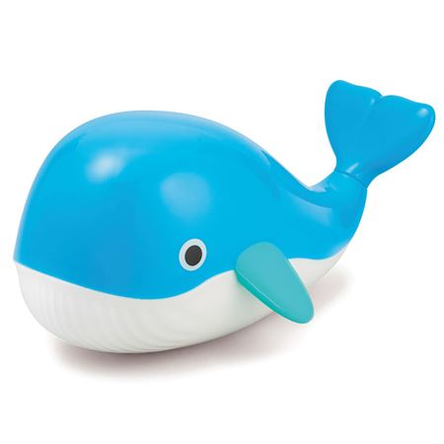




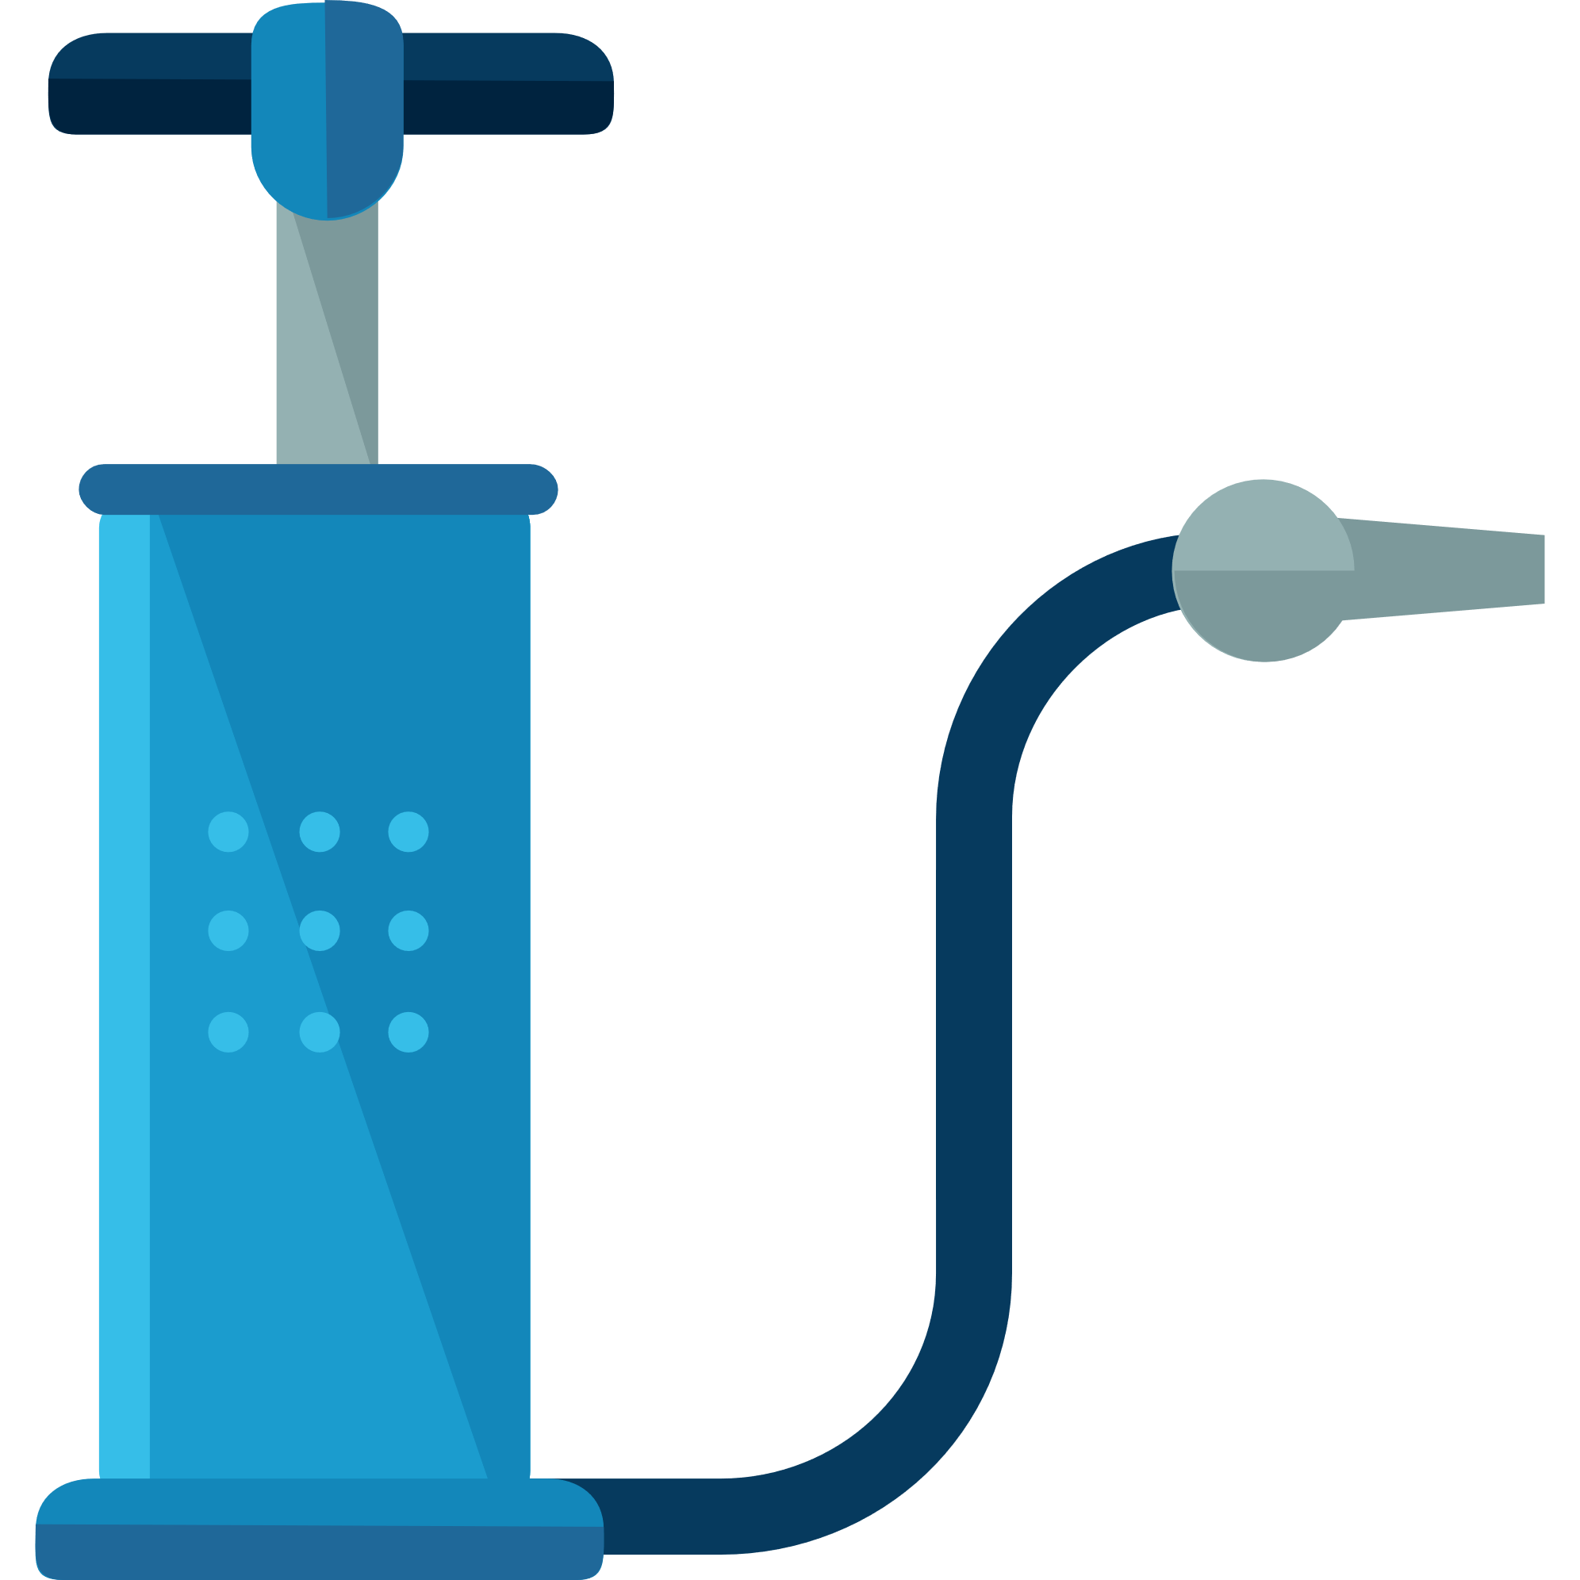



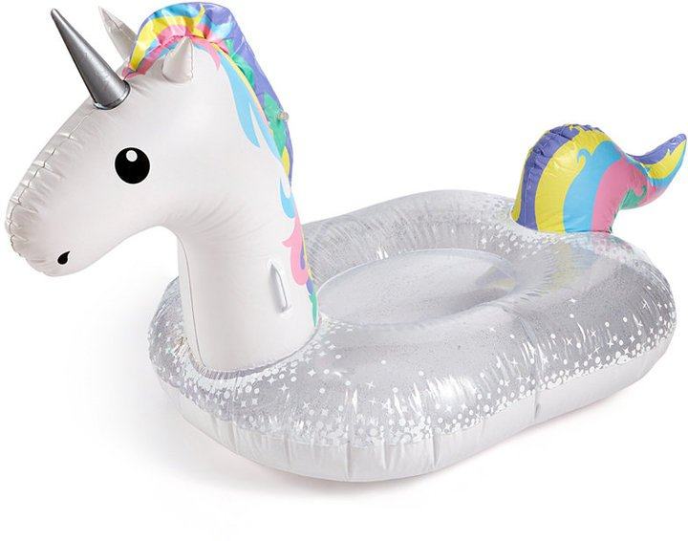
Current Build Infrastructure
Build, Integrate, Test
Hosted Build Agent Pool
Contoso – Build Pool
Northwind – Build Pool

Slide 7
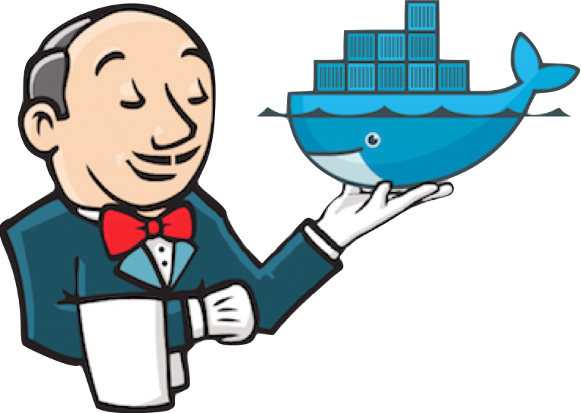
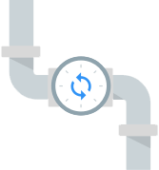


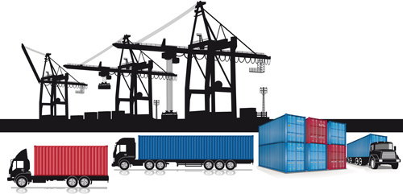
Container Builds - using a Container Mindset
Build, Integrate, Test
Hosted Build Agent Pool

Slide 8
ACR Tasks A primitive of container lifecycle management
aka.ms/acr/tasks

Slide 9



Azure Kubernetes Service (AKS)
Azure Container Registry Tasks
Run task based jobs using graphs of containers
App Service
Azure Container Instances (ACI)
Enable applications and algorithms to easily and efficiently run in parallel at scale.
Run Batch tasks without having to manage an environment and dependencies.
Package, execute, and scale your High Performance Computing applications and batch workloads in a consistent, reproducible manner.
Service Fabric
Azure Batch
Azure Container Registry (ACR)

Slide 10




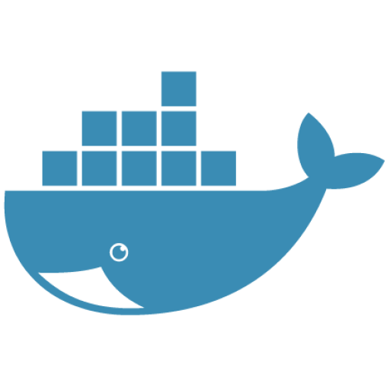


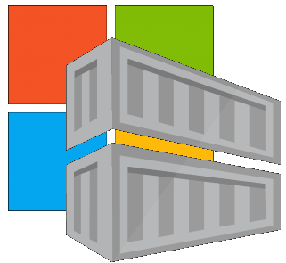

Container Lifecycle Primitives
Host agents monitor, protect and report running containers
3
Container Service
Container Instances
Source Code Control
(SCC)
Build/CI,
Integrate,
Test
CD, Deploy
7
App Services
Upon release, set released flag in ACR (ACR-Auto-purge policies)
Service Fabric
.NET
6
Base Image Index
4
8
1
2
Azure Functions
Docker Hub
ACR Tasks
Azure Container Registry
IoT
Azure Container Registry
Image Security Scanning
Secure by default
Microsoft Container Registry
Inner-Loop
Azure Batch
Run
5
Code
Validate
Debug
* Work in progress

Slide 11




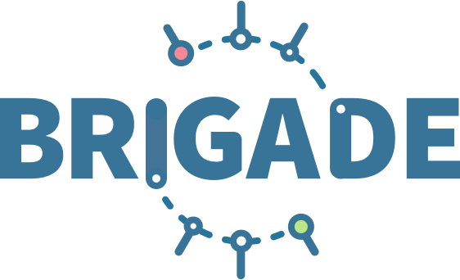
ACR Tasks: Container OS & Framework Patching
.NET
Registries
Docker Hub
MCR
ACR
Build Triggers
SCC Providers
ACR Tasks
Azure Container Registry
aka.ms/acr/tasks

Slide 12

Container Lifecycle Primitives

Slide 13


Dockerfile FROM
Functional Tests
Base Images
Commit Id
Task
Id
Context
Dependencies
ACR
d5ab1fa
fx:1
fx:1^{(a)}
fx:1
Web-Build
1
fx:1
web:sha@la
web:1
deploy/test
deploy
web:1
web:1
test:t
Context
d5ab1fa
test:1
Dependencies
web:1
Integration Env
FROM jenga.azurecr.io/baseimages/fx:1
COPY . /output
EXPOSE 80
ENTRYPOINT ["entryPoint"]
If docker build succeeds (including any unit tests),
Save the context & base image dependencies
web:1
az acr task create \
–n Web-Build \
–t web:${{.Run.ID}} \
–c github.com/demo42/web \
–-git-access-token $PAT \
–r jenga
Staging Env

Slide 14
Dockerfile FROM
Functional Tests
Base Images
Commit Id
Task
Id
Context
Dependencies
ACR
fx:1^{(a)}
fx:1
d5ab1fa
Web-Build
1
fx:1
web:sha@la
web:1
deploy/test
deploy
Context
fx:1^{(b)}
fx:1^{(b)}
2
fx:1^{(b)}
web:sha@ya
web:2
deploy/test
deploy
web:2
web:2
d5ab1fa
test:2
test:2
Dependencies
fx:1^{(a)}
web:2
fx ships an OS &/or FX Patch, using the stable 1 tag
The build-task is monitoring changes based on the last build
Integration Env
Base image updates restore the previous context
If Build & Unit Tests Succeed,
Update the base image dependencies
web:2
Staging Env

Slide 15
Dockerfile FROM
Functional Tests
Base Images
Commit Id
Task
Id
Context
Dependencies
ACR
fx:1^{(a)}
d5ab1fa
Web-Build
fx:1
fx:1
Web-Build
1
web:sha@la
web:1
deploy/test
deploy
Context
fx:1^{(b)}
fx:1^{(b)}
2
fx:1^{(b)}
web:sha@ya
web:2
deploy/test
deploy
web:2
web:2
ef26q5c
test:2
d5ab1fa
test:3
fx:2^{(d)}
fx:2^{(d)}
fx:2
ef26q5c
3
fx:2^{(d)}
web:sha@qe
web:3
deploy/test
deploy
web:3
web:3
Dependencies
test:4
Dependencies
fx:1^{(a)}
fx:1^{(b)}
web:3
FROM jenga.azurecr.io/baseimages/fx:2
COPY . /output
EXPOSE 80
ENTRYPOINT ["entryPoint"]
Integration Env
web:2
web:3
If docker build succeeds (including any unit tests),
Save the context & base image dependencies
Staging Env
Container OS & Framework Patching

Slide 16

Contoso (Returns)
1 Pull Request
= 1 Build
= 1 Push
= 1 Scan
= 1 Test
= 1 Deploy
$$(1pr=1b+1p+ 1t+1d) ∗life of development$$
Contoso (*)
= 1 Build
= 1 Push
= 1 Scan
= 1 Test
= 1 Deploy
= 1 Build
= 1 Push
= 1 Scan
= 1 Test
= 1 Deploy
= 1 Build
= 1 Push
= 1 Scan
= 1 Test
= 1 Deploy
.NET
Northwind
= 1 Build
= 1 Push
= 1 Scan
= 1 Test
= 1 Deploy
= 1 Build
= 1 Push
= 1 Scan
= 1 Test
= 1 Deploy
= 1 Build
= 1 Push
= 1 Scan
= 1 Test
= 1 Deploy
Smart Hotel 360
= 1 Build
= 1 Push
= 1 Scan
= 1 Test
= 1 Deploy
= 1 Build
= 1 Push
= 1 Scan
= 1 Test
= 1 Deploy
= 1 Build
= 1 Push
= 1 Scan
= 1 Test
= 1 Deploy
Adventure Works
= 1 Build
= 1 Push
= 1 Scan
= 1 Test
= 1 Deploy
= 1 Build
= 1 Push
= 1 Scan
= 1 Test
= 1 Deploy
= 1 Build
= 1 Push
= 1 Scan
= 1 Test
= 1 Deploy
Fabrikam
= 1 Build
= 1 Push
= 1 Scan
= 1 Test
= 1 Deploy
= 1 Build
= 1 Push
= 1 Scan
= 1 Test
= 1 Deploy
= 1 Build
= 1 Push
= 1 Scan
= 1 Test
= 1 Deploy
$$1patch=cust ∗apps ∗ \left(1b+1p+ 1t+1d\right)∗life of the app$$

Slide 17
Image Tagging
Why stable tagging can create instability

Slide 18
HOST-A
Deploy:
web:1 x3
quotes:1 x3
important:1 x4
Image Cache
3
web:1
digest: 91e
web:1
digest: 91e
Foo:
web:1 x3
quotes:1 x3
important:1 x4
web:1
digest: 91e
quotes:1
digest: u82
quotes & important are in inconsistent states
1
important:1
digest: 2re
important:1
digest: 2re
docker build –t web:1
docker build –t quotes:1
docker build –t important:1
docker images
REPOSITORY TAG DIGEST
web 1 91e
quotes 1 u82
important 1 2re
docker push web:1
docker push quotes:1
docker push important:1
HOST-B
Image Cache
quotes:1
digest: u82
quotes:1
digest: u82
9
8
web:1
digest: 91e
5
important:1
digest: 2re
quotes:1
digest: 3rp
important:1
digest: 1n4
important:1
digest: 2re
quotes:1
digest: u82
quotes:1
digest: u82
important:1
digest: 2re
important:1
digest: 2re
Digests
91e
u82
2re
Image
web:1
quotes:1
important:1
2
Digests
91e
u82
2re
3rp
1n4
web:1
digest: 91e
HOST-C
quotes:1
digest: u82
7
4
important:1
digest: 2re
Image Cache
quotes:1
digest: 3rp
quotes:1
digest: 3rp
6
docker build –t quotes:1
docker build –t important:1
docker images
REPOSITORY TAG DIGEST
quotes 1 3rp
important 1 1n4
docker push quotes:1
docker push important:1
important:1
digest: 1n4
important:1
digest: 1n4
quotes:1
digest: 3rp
important:1
digest: 1n4
Notes:
Orchestrator icon from: http://cdn.marketplaceimages.windowsphone.com/v8/images/f58edb21-b20c-4315-b837-6cee21n442cd?imageType=ws_icon_large
https://git-scm.com/book/en/v2/Git-Branching-Basic-Branching-and-Merging

Slide 19
Tagging Techniques
Base Images
FROM …
Stable Tags
Tag
:latest
:1
:2
:3
:1.0
:1.1
:1.2
:2.0
:2.1
:3.0
Digest
91efj6
u82lq
2re7f
3rpn1
1n4ef
5wd1k
Servicing Stable Tags
Tag
:latest
:1
:2
:1.0
:1.1
:1.2
:2.0
Digest
91efj6
u82lq
e8s1f
1n4ef
2re7f
3rpn1
28efq
Deployed Images
docker run …
Unique Tagging
Tag
:12204
:12328
:12401
:33810
:35091
:4201
:50201
Digest
91efj6
u82lq
e8s1f
1n4ef
2re7f
3rpn1
28efq
Notes:
[‎2/‎23/‎2018 3:18 PM] Sajay Antony:
https://git-scm.com/book/en/v2/Git-Branching-Basic-Branching-and-Merging
[‎2/‎23/‎2018 3:37 PM] Sajay Antony:
https://docs.docker.com/storage/storagedriver/
[‎2/‎23/‎2018 4:00 PM] Sajay Antony:
https://www.cockos.com/licecap/
[‎2/‎23/‎2018 5:10 PM] Sajay Antony:
https://docs.docker.com/datacenter/dtr/2.4/guides/user/create-promotion-policies/

Slide 20


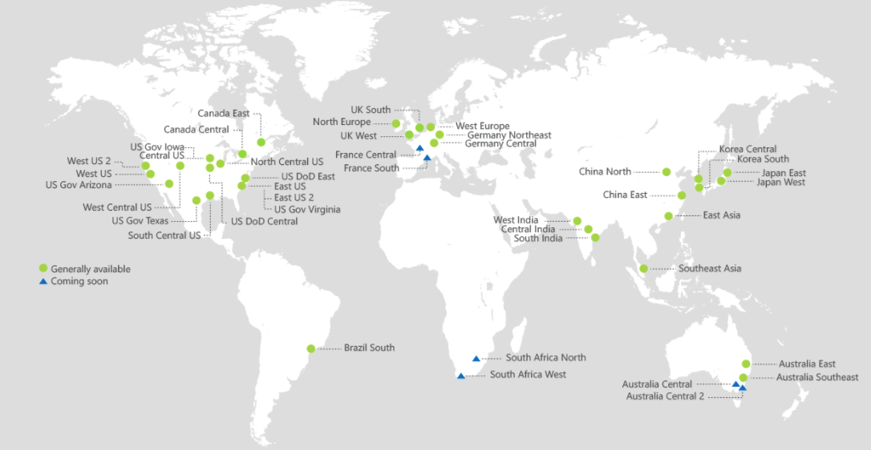
ACR Geo-replication
Mange your global/local deployments as one resource
http://aka.ms/acr/geo-replication

Slide 21
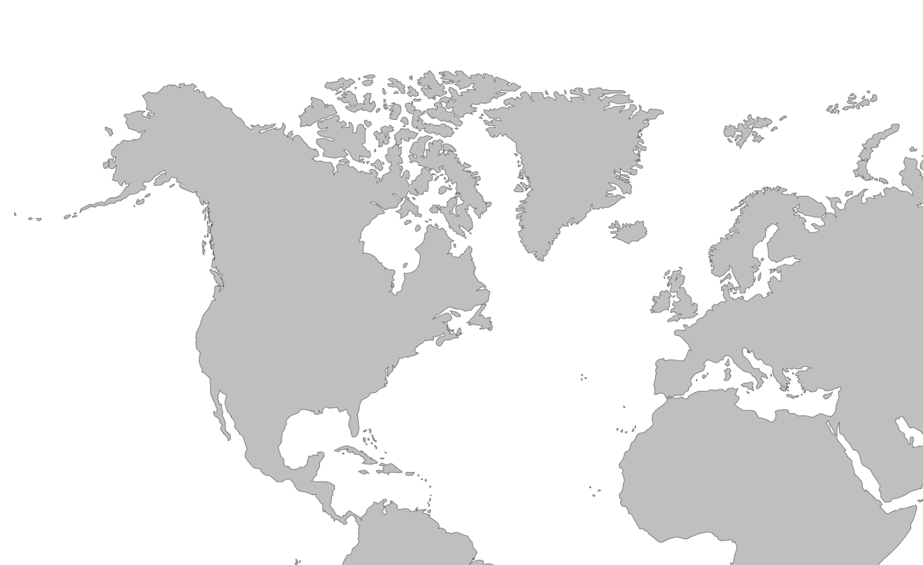

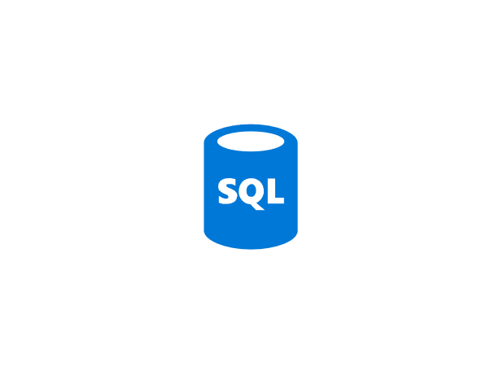

Push Built Images
docker push contosowestus.azurecr.io/web:1234
docker push contosowesteurope.azurecr.io/web:1234
Nodes Pull Images
docker pull contosowestus.azurecr.io/web:1234
docker pull contosowesteurope.azurecr.io/web:1234
Pulls are local, network-close, fast, reliable
Pulls are remote, across the public internet, slower, less reliable
Have network egress fees
Pulls are remote, across the public internet, slower, less reliable
Have network egress fees
West Europe
Canada Central
West US
East US
Developers must push images to n registries, requiring separate management and configuration

Slide 22

Push Built Images
docker push contoso.azurecr.io/web:1234
ACR Syncs Image Blobs
Regional Web Hooks fire for local deployments
Nodes Pull Images
docker pull contoso.azurecr.io/web:1234
Geo-replicate a single registry
All regions have a local replica
Geo-replicate a single registry
All regions have a local replica
West Europe
Canada Central
West US
East US
Each registry is pulling from a local, network close, reliable registry

Slide 23
Azure Container Registry
Providing a single registry across the globe
aka.ms/ACR
aka.ms/ACR/Docs
aka.ms/ACR/Geo-replication
aka.ms/ACR/Roadmap

Slide 24

User Authentication
Using familiar docker CLIs
Individual Identity, using Azure Active Directory Identity
az login
az acr login --name demo42
docker push / pull

Slide 25
Service Authentication
Server/Headless identity using AAD Service Principals
Provision Service Principals, with scoped access control
Contributor – Push/Pull
Reader – Pull Only
Eg: assign the Kubernetes created principal, with reader role
az login --service-principal \
--tenant wabbit.com \
-u http://myapp-id \
-p WeryWerySecwet
az acr login --name demo42
docker push / pull
docker login demo42.azurecr.io \
-u http://myapp-id \
-p WeryWerySecwet
docker push / pull

Slide 26
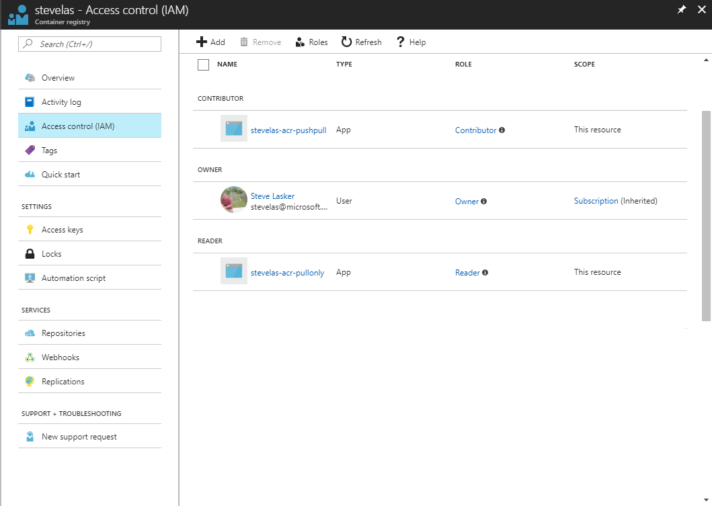
Owner – Push, Pull, ARM Resource Management eg: IAM configuration
Contributor – Push, Pull
Reader – Pull Only

Slide 27
*Container Registries Secured by Default
Enabling Secure By Default Registries
* Private Preview Q4 2018

Slide 28

Secured By Default
Build/Push
Azure Container Registry
Container Hosts
Quarantine Tag
Digest
Tag
91efj6
:1.0
:1.1
u82lq
:1.2
e8s1f
Shifting the container scanning to the left
Partnering with:

Slide 29

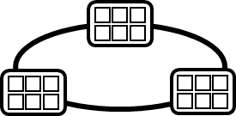
Container Service
Run, Manage
1
Release Management
Container Instances
docker push acrdemos.azurecr.io/th:1.0
Azure Container Registry
Production
environments
App Services
5
6
2
{
"id": "0d799b14-404b-4859-b2f6-50c5ee2a2c3a",
"timestamp": "2018-02-28T00:42:54.4509516Z",
"action": "push-quarantined",
"target": {
"size": 1791,
"digest": "sha256:91ef6
"length": 1791,
"repository": “th",
"tag": "1.0"},
"request": {
"id": "978fc988-1e06-49ee-bf71-4f6e331d1591",
"host": “acrdemos.azurecr.io",
"method": "PUT"}
}
{
"id": "0d799b14-404b-4859-b2f6-50c5ee2a2c3a",
"timestamp": "2018-02-28T00:42:56.4509516Z",
"action": "push",
"target": {
"size": 1791,
"digest": "sha256:91ef6
"length": 1791,
"repository": “th",
"tag": "1.0"},
"request": {
"id": "978fc988-1e06-49ee-bf71-4f6e331d1591",
"host": “acrdemos.azurecr.io",
"method": "PUT"}
}
3
docker pull th@sha256:91ef6
4
az acr policy set –n acrdemos --quarantine-remove –-image th@sha256:91ef6
or
az acr policy set –n acrdemos --quarantine-block –-image th@sha256:91ef6
Notes:
{
"id": "0d799b14-404b-4859-b2f6-50c5ee2a2c3a",
"timestamp": "2018-02-28T00:42:54.4509516Z",
"action": "push-quarantined",
"target": {
"mediaType": "application/vnd.docker.distribution.manifest.v2+json",
"size": 1791,
"digest": "sha256:91ef6
"length": 1791,
"repository": “th",
"tag": "1.0"
},
"request": {
"id": "978fc988-1e06-49ee-bf71-4f6e331d1591",
"host": "jengademos.azurecr-test.io",
"method": "PUT",
"useragent": "docker/18.03.0-ce-rc1 go/go1.9.4 git-commit/c160c73 kernel/4.9.75-linuxkit-aufs os/linux arch/amd64 UpstreamClient(Docker-Client/18.03.0-ce-rc1 \\(windows\\))"
}
}

Slide 30
Quarantine – Image Access
docker push acrdemos.azurecr.io/th:1.0
docker push acrdemos.azurecr.io/th:1.0
docker pull th@sha256:91ef6
docker pull th@sha256:e8s1f
az acr policy set –n acrdemos --quarantine-remove –-image th@sha256:91ef6
az acr policy set –n acrdemos --quarantine-remove –-image th@sha256:e8s1f
docker push acrdemos.azurecr.io/th:1.1
docker push acrdemos.azurecr.io/th:1.0
docker pull th@sha256:u82lq
docker pull th@sha256:3r2s7
az acr policy set –n acrdemos --quarantine-remove –-image th@sha256:u82lq
az acr policy set –n acrdemos --quarantine-fail –-image th@sha256:3r2s7
Tag
Digest
91efj6
u82lq
e8s1f
3r2s7
Quarantine Tag
:1.0
:1.1
:1.0
:1.0

Slide 31

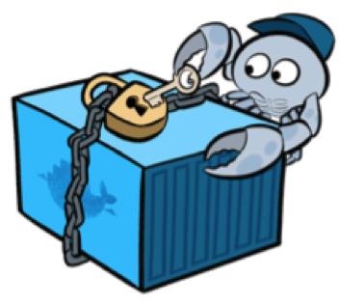

Image Signing Content Trust
Securing images from source to destination
* Public Preview Q4 2018

Slide 32




Content Trust
docker push
docker pull
acr
 Content Trust Enabled,
api
api
Images
Signatures
* Public Preview Q4 2018

Slide 33
Helm Chart Repositories
Core Capability of Azure Container Registry
Store Helm Charts, alongside Images
Share common authentication
Geo-replicated & redundant

Slide 34
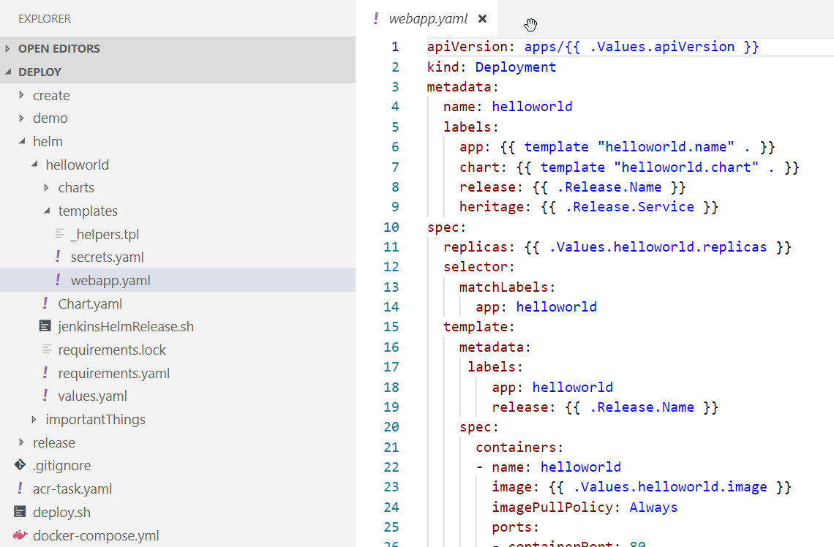
Helm Chart Repositories

Slide 35
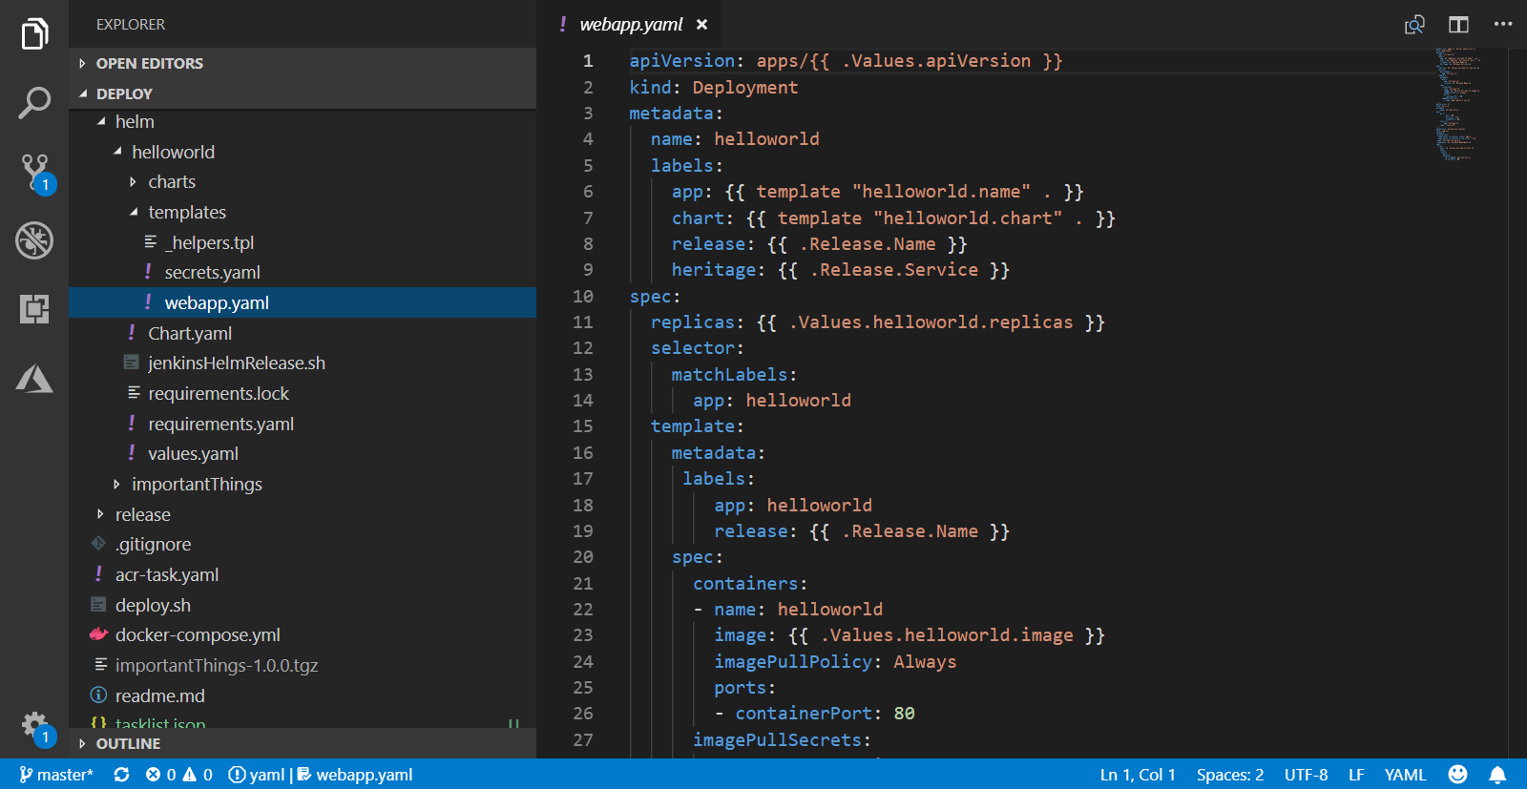
Helm Chart Repositories

Slide 36
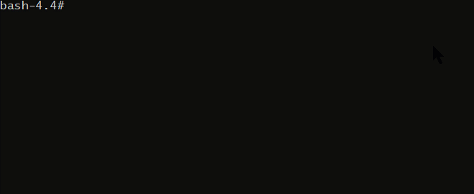
Helm Chart Repositories

Slide 37
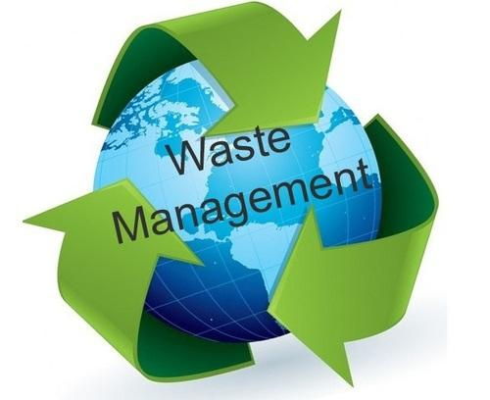
Image Policies
Managing image storage and lifecycle

Slide 38






Image Policies
Azure Container Registry
Policies
Quarantine 7 days
Default 14 days
Release 3 years
Released
TTL 1/1/21
Quarantined TTL 1/7/18
Default
TTL 1/14/18

Slide 39
Additional Features Coming 2019
Repo Level RBAC (Images & Charts)
Time Based Tokens
Public/Anonymous Access
Self Diagnostic Audit Logging
Image Usage Telemetry
On-Prem Replicated Node
Gitlab Support

